Slide 1
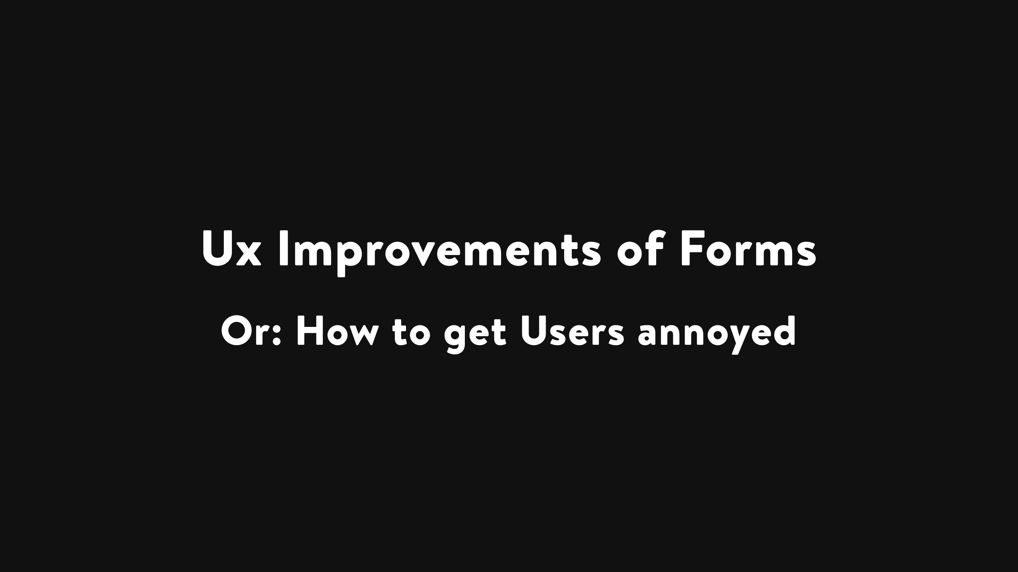
Notes:
Hello everyone, nice that you showed up - I'm not a native english speaker nontheless the talk will be in english - spoiler not an accessibility talk there have been other talks with that focus

Slide 2
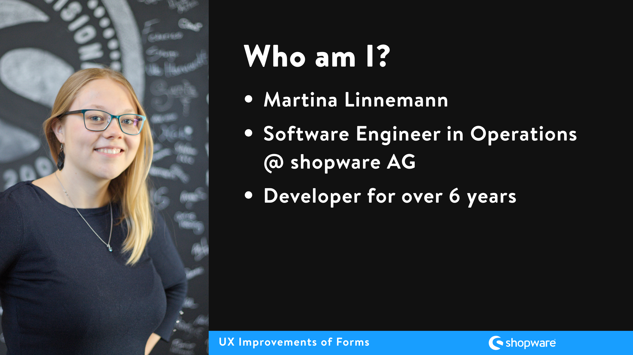

Slide 3
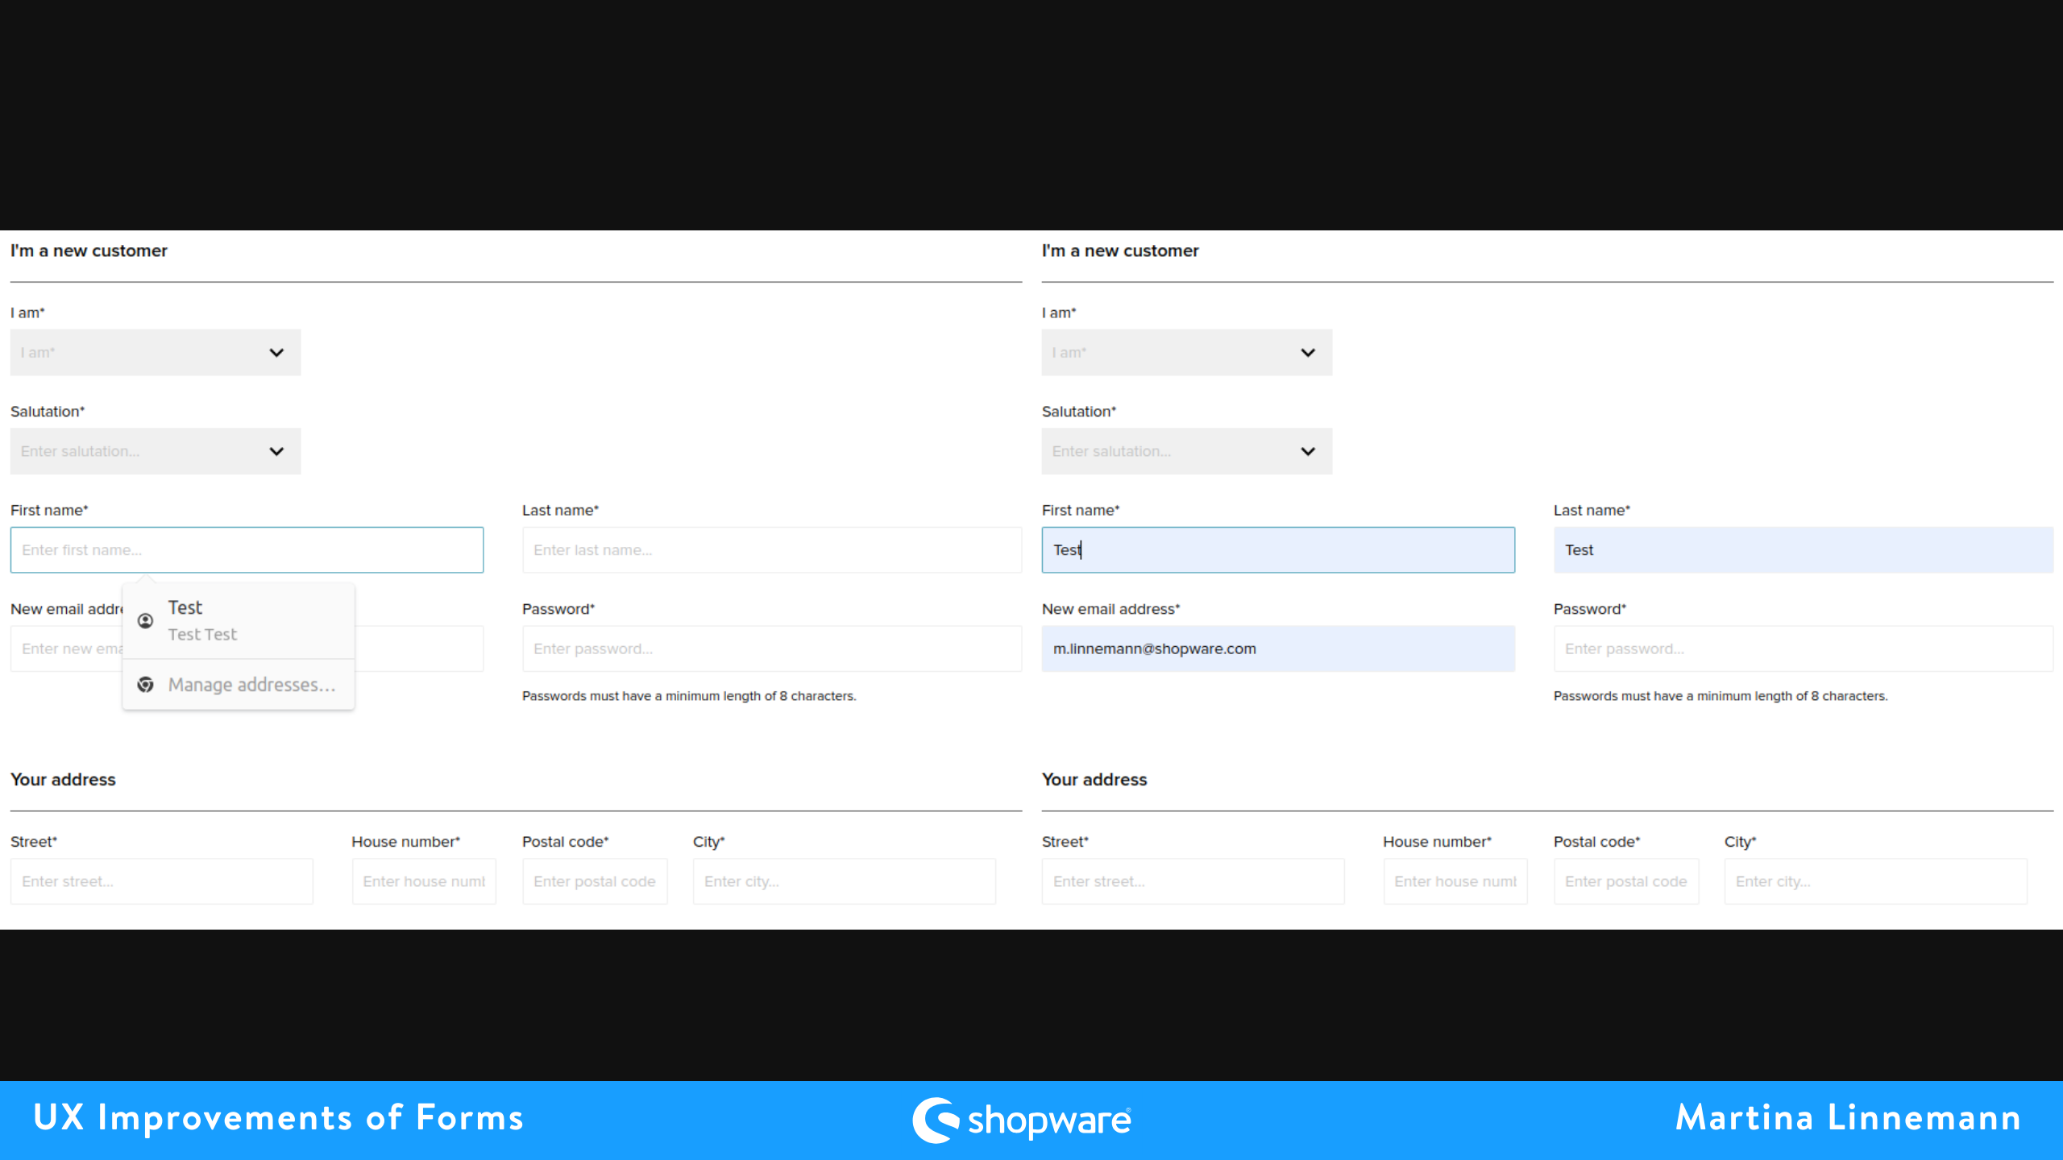
Notes:
Imagine your browser has autosaved your address, email address etc., you want to fill in a form and in one field it suggests the correct value and you want to use it but if you click on it it also fills in other fields with a wrong value. Do you feel frustrated?

Slide 4
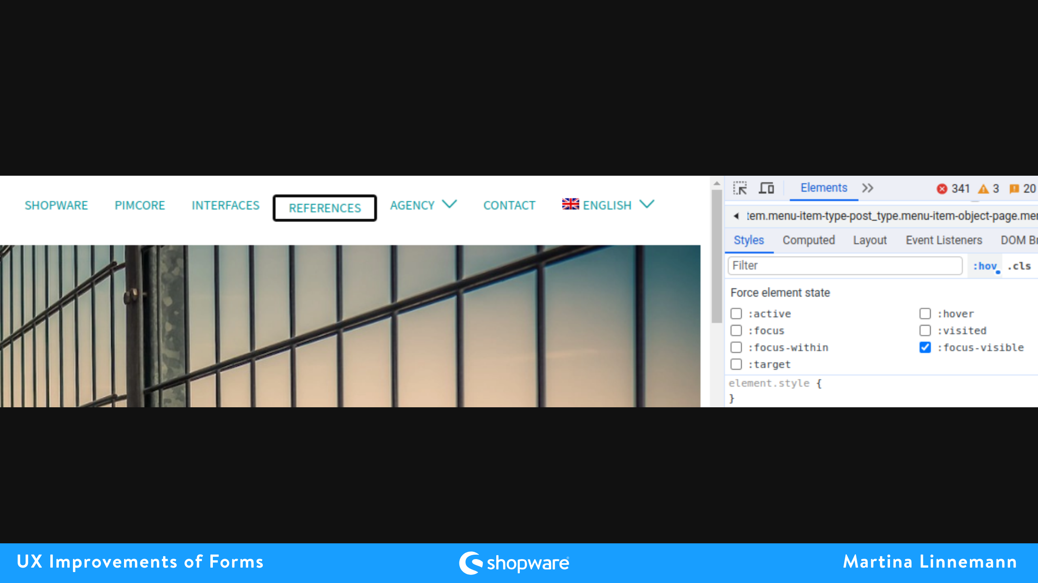
Notes:
only visible if adjusted or maybe even not focusable via keyboard navigation

Slide 5


Slide 6
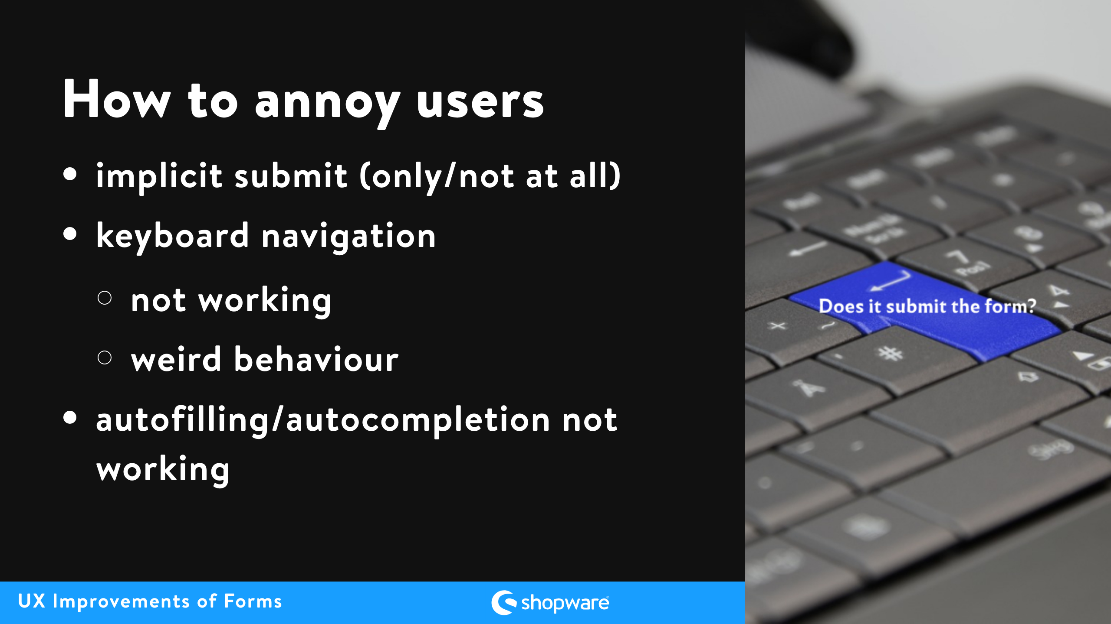

Slide 7
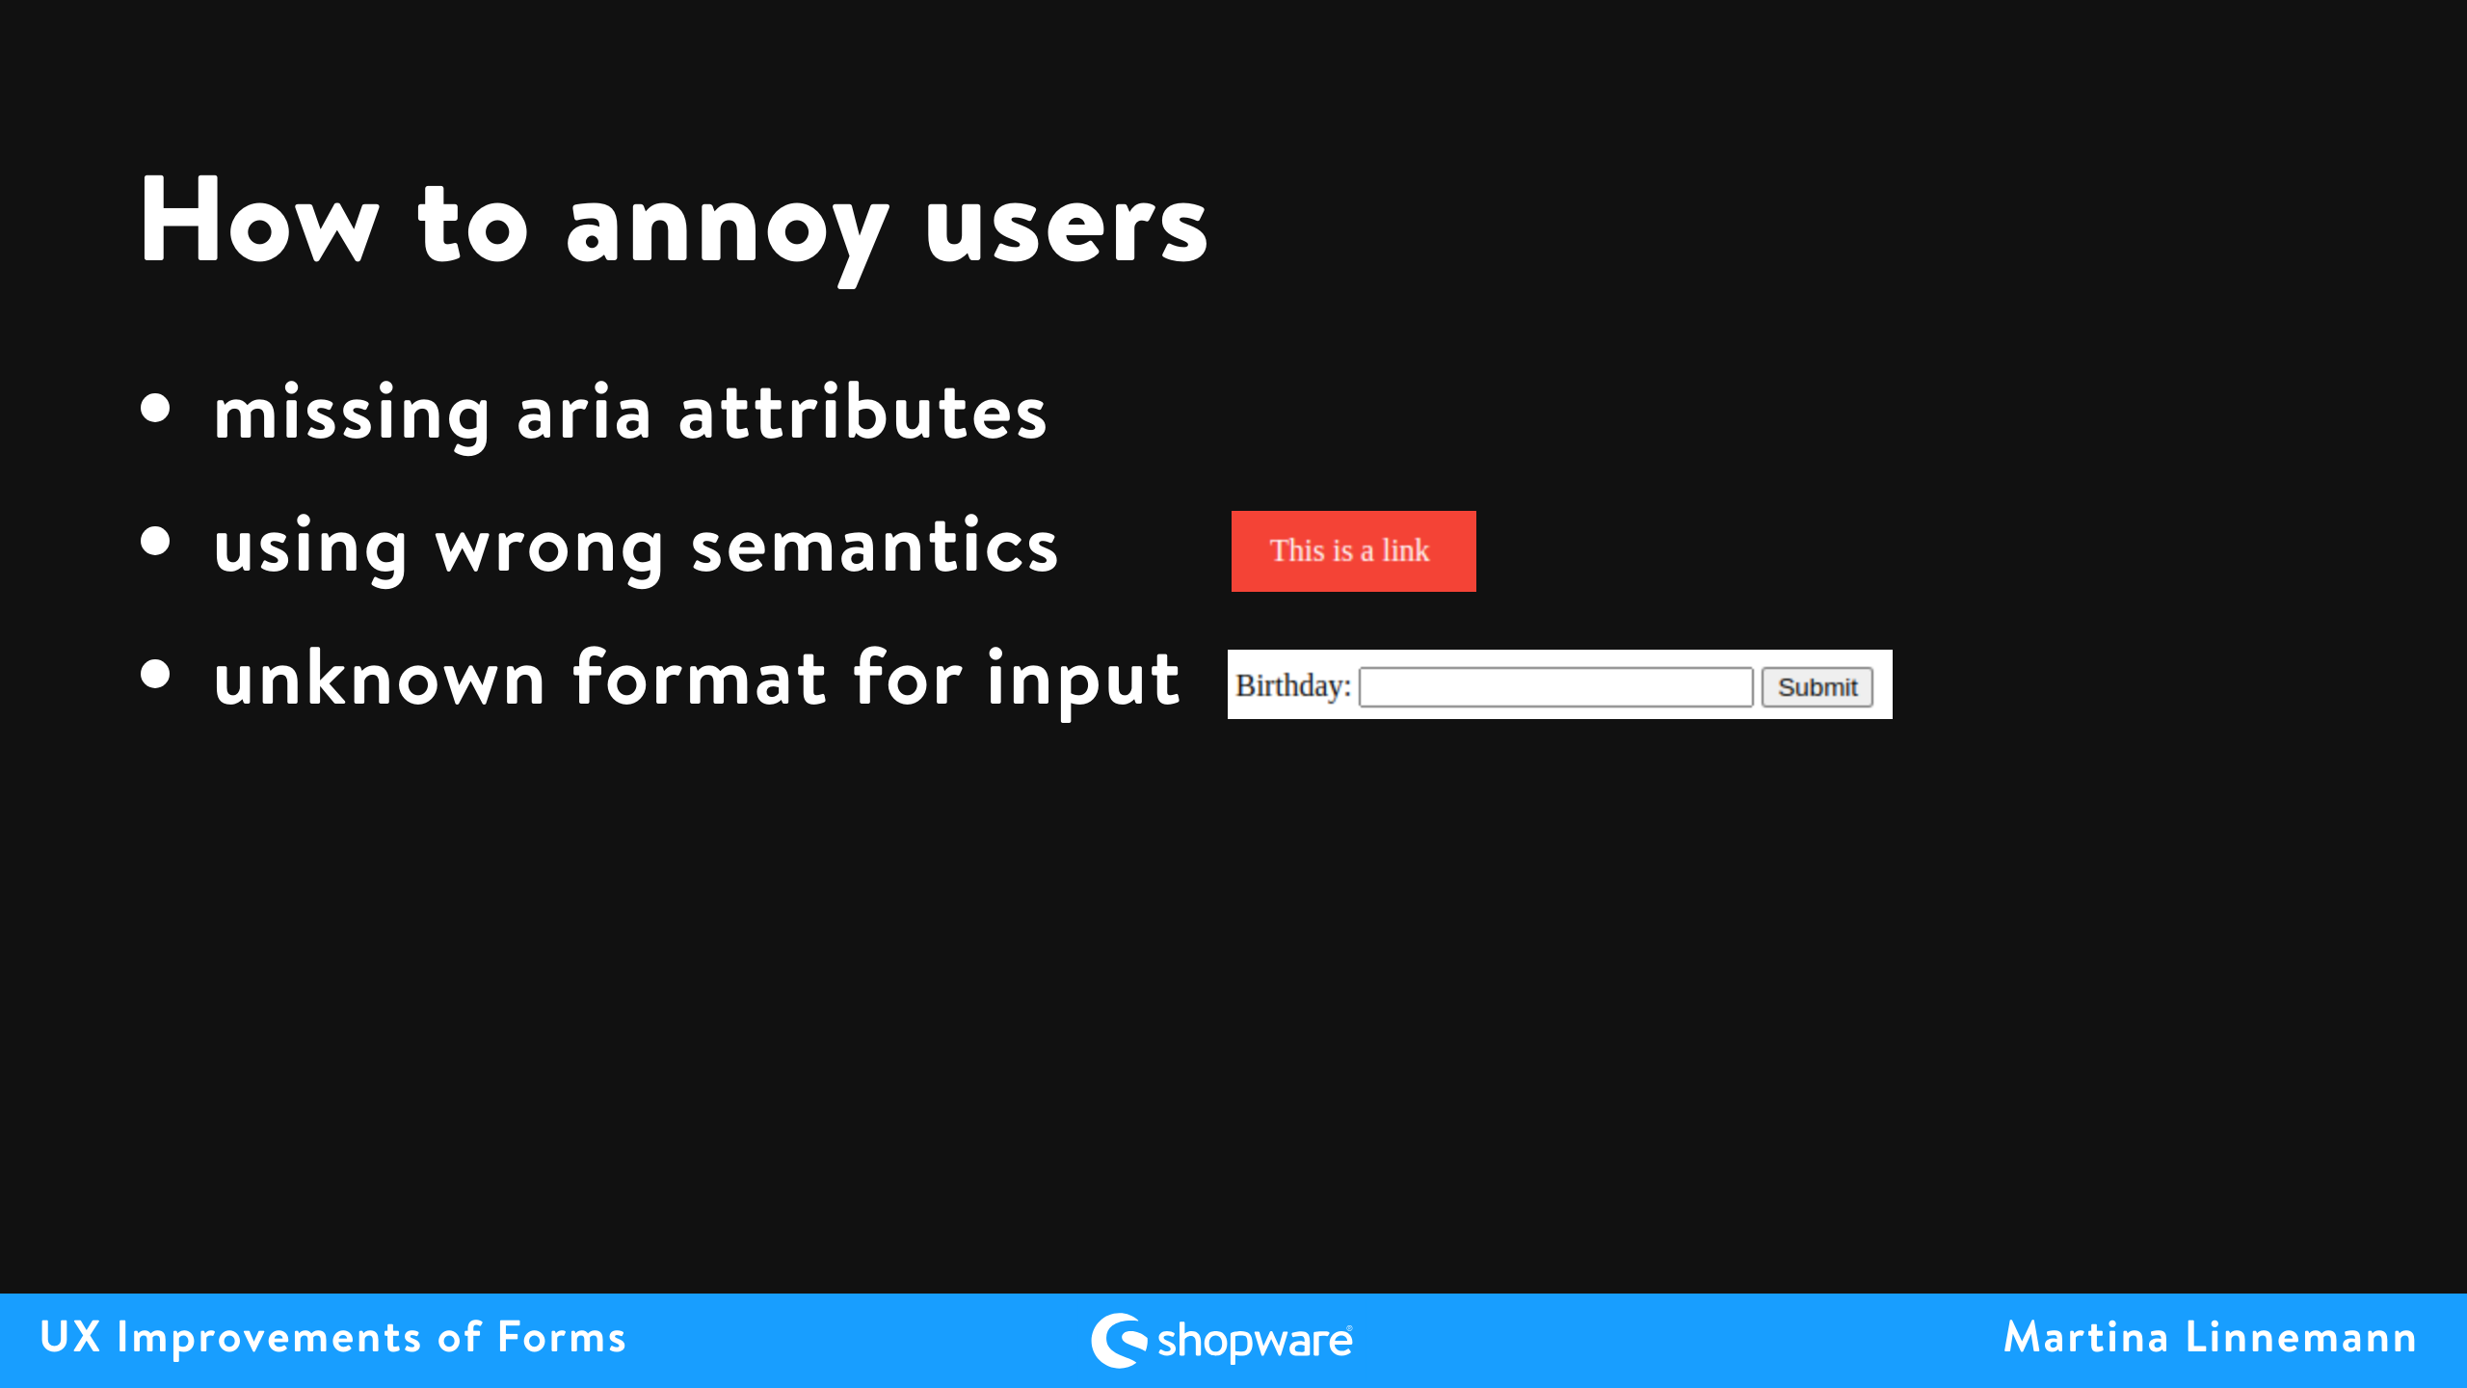
Notes:
- missing aria attributes & wrong semantics = hell for users of screen readers - with non supporting browsers

Slide 8
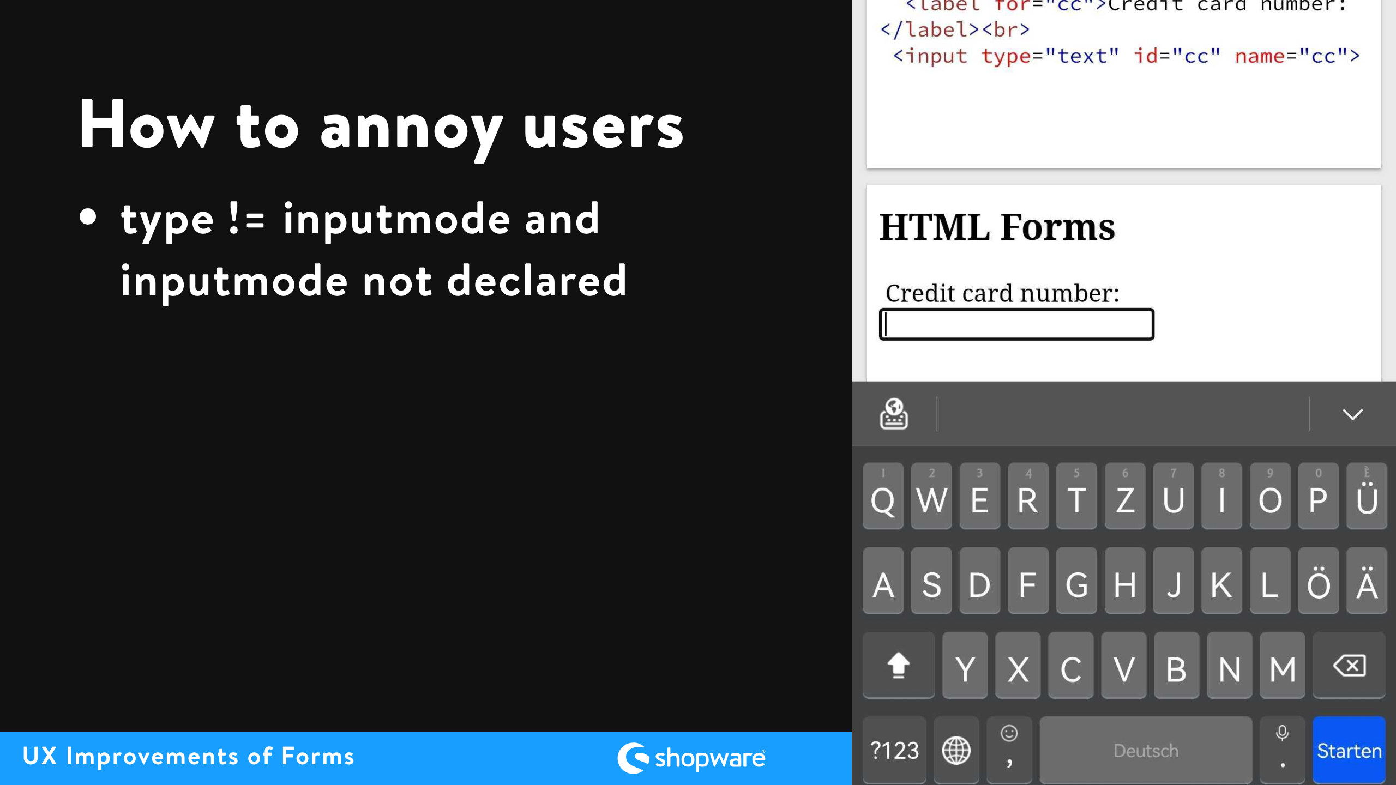
Notes:
always remember the next person to be annoyed could be you

Slide 9
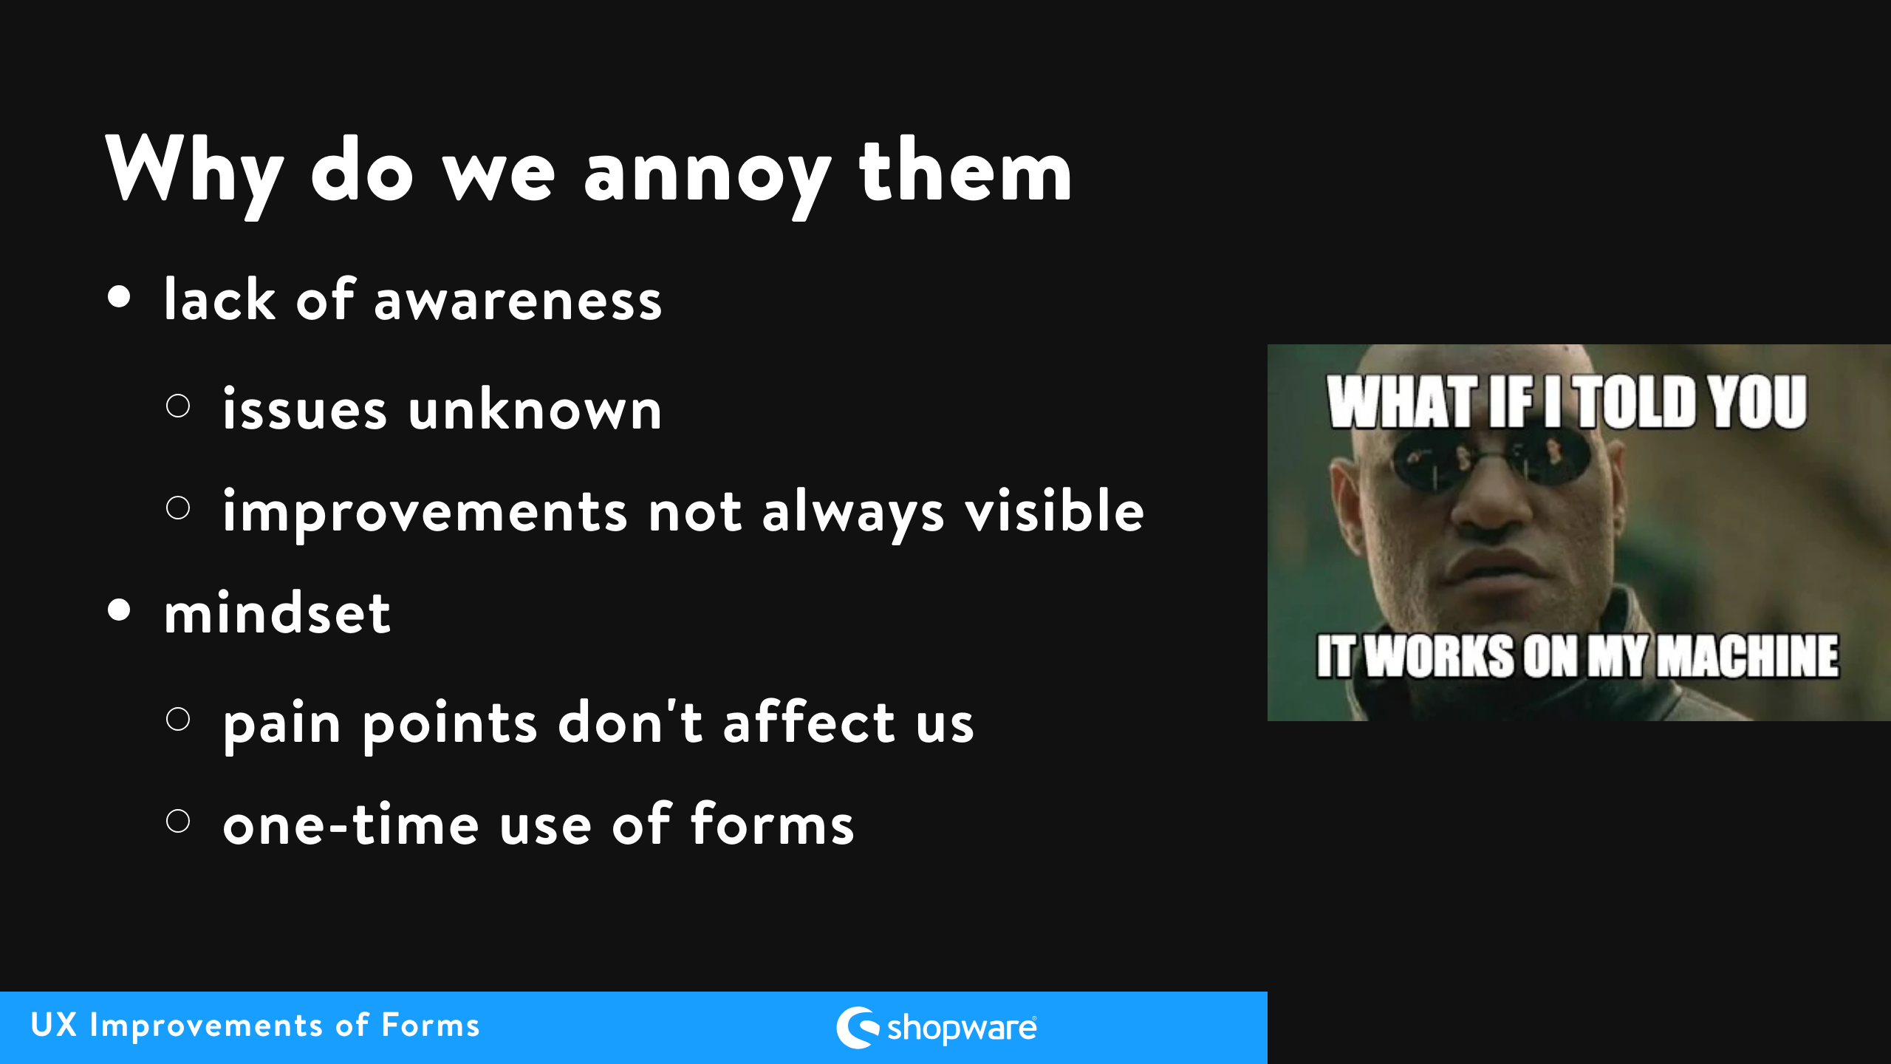
Notes:
therefore repetition of easy improvements can lead to necessary mindset changes

Slide 10
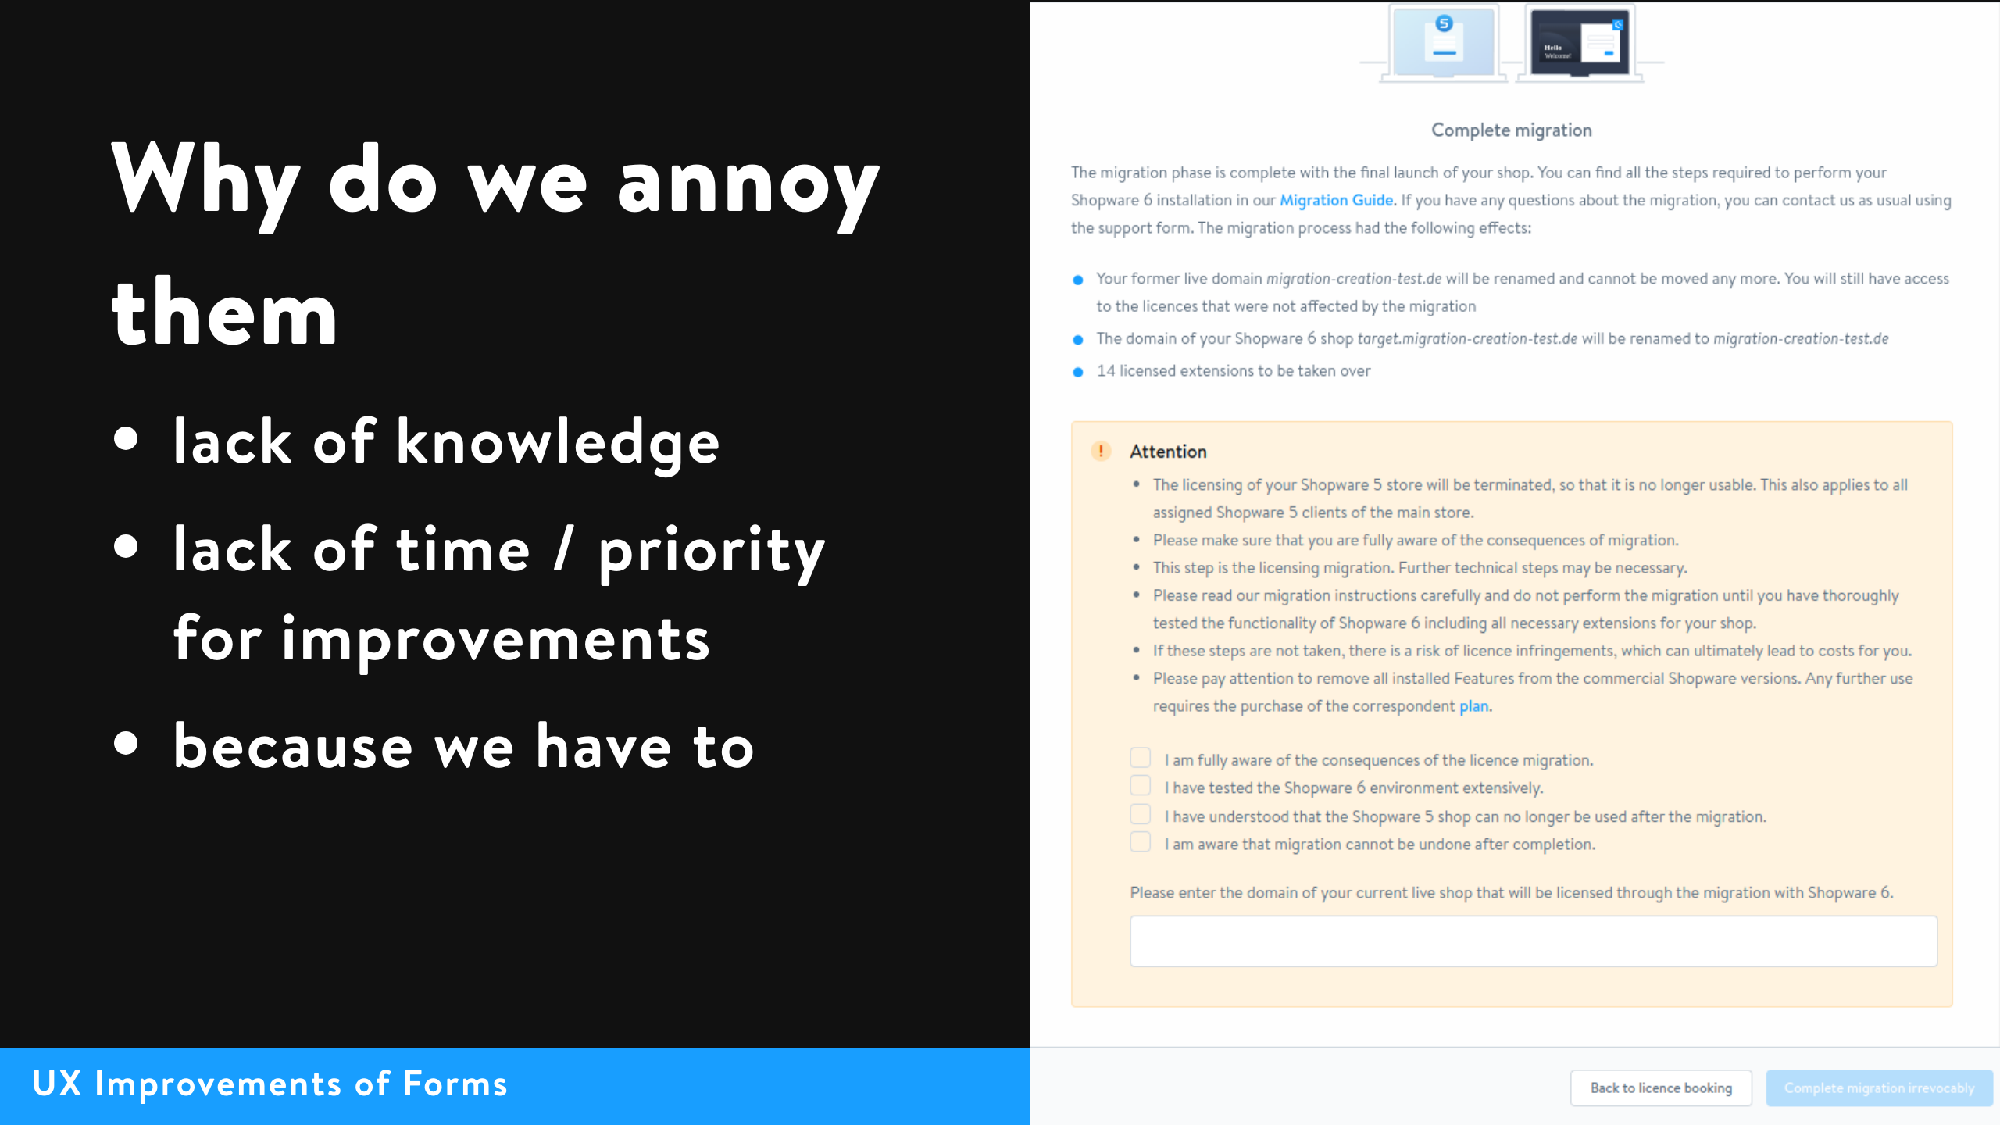
Notes:
- e.g. student, might not know how autocompletion works and what needs to be done for it to work correctly - have to: story about migration assistant checkboxes and input field to prevent users to finalize it and afterward complain about it not being reversable although it was clearly stated as not reversable

Slide 11


Slide 12

Notes:
- goal - personas - accessibility

Slide 13
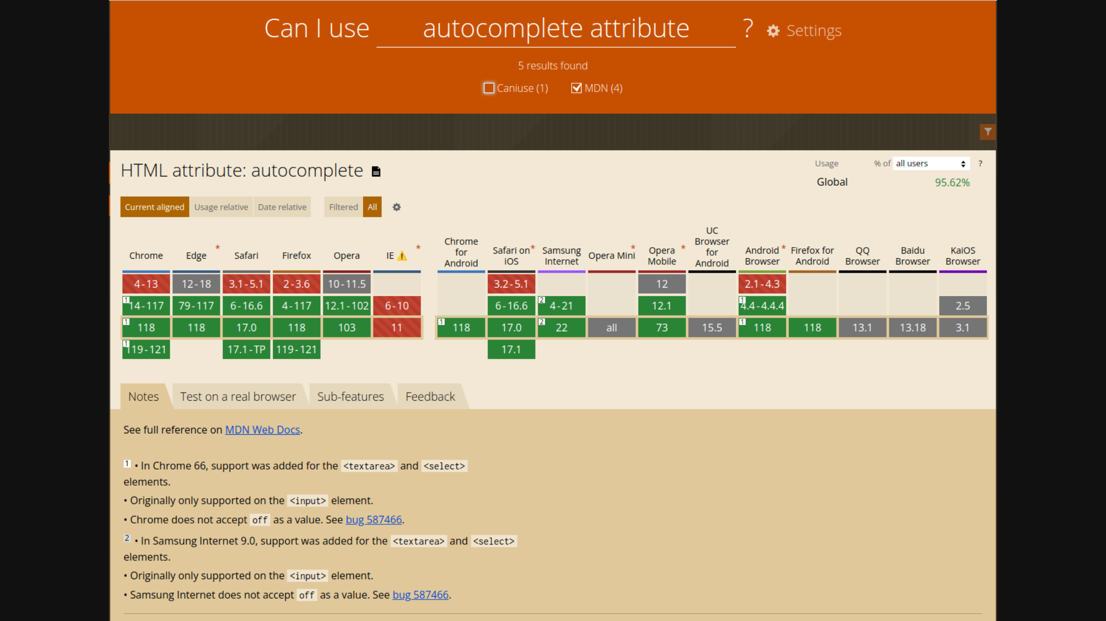

Slide 14


Slide 15
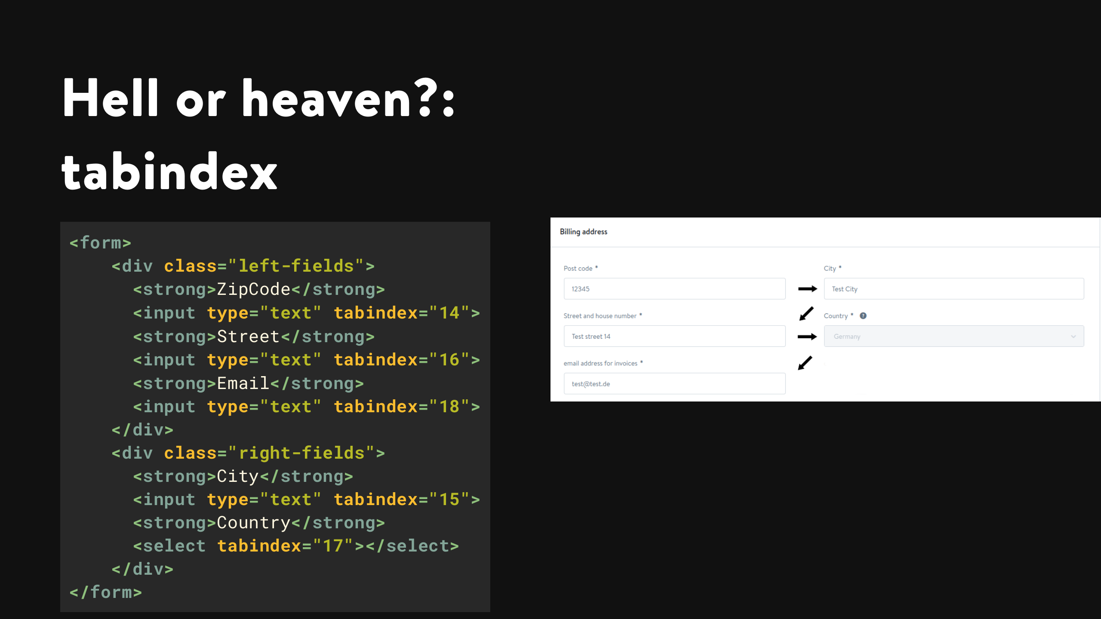
Notes:
- semantics also not good for screenreaders - often hell, only heaven for small pages (one form) if the default behaviour is counter intuitive

Slide 16
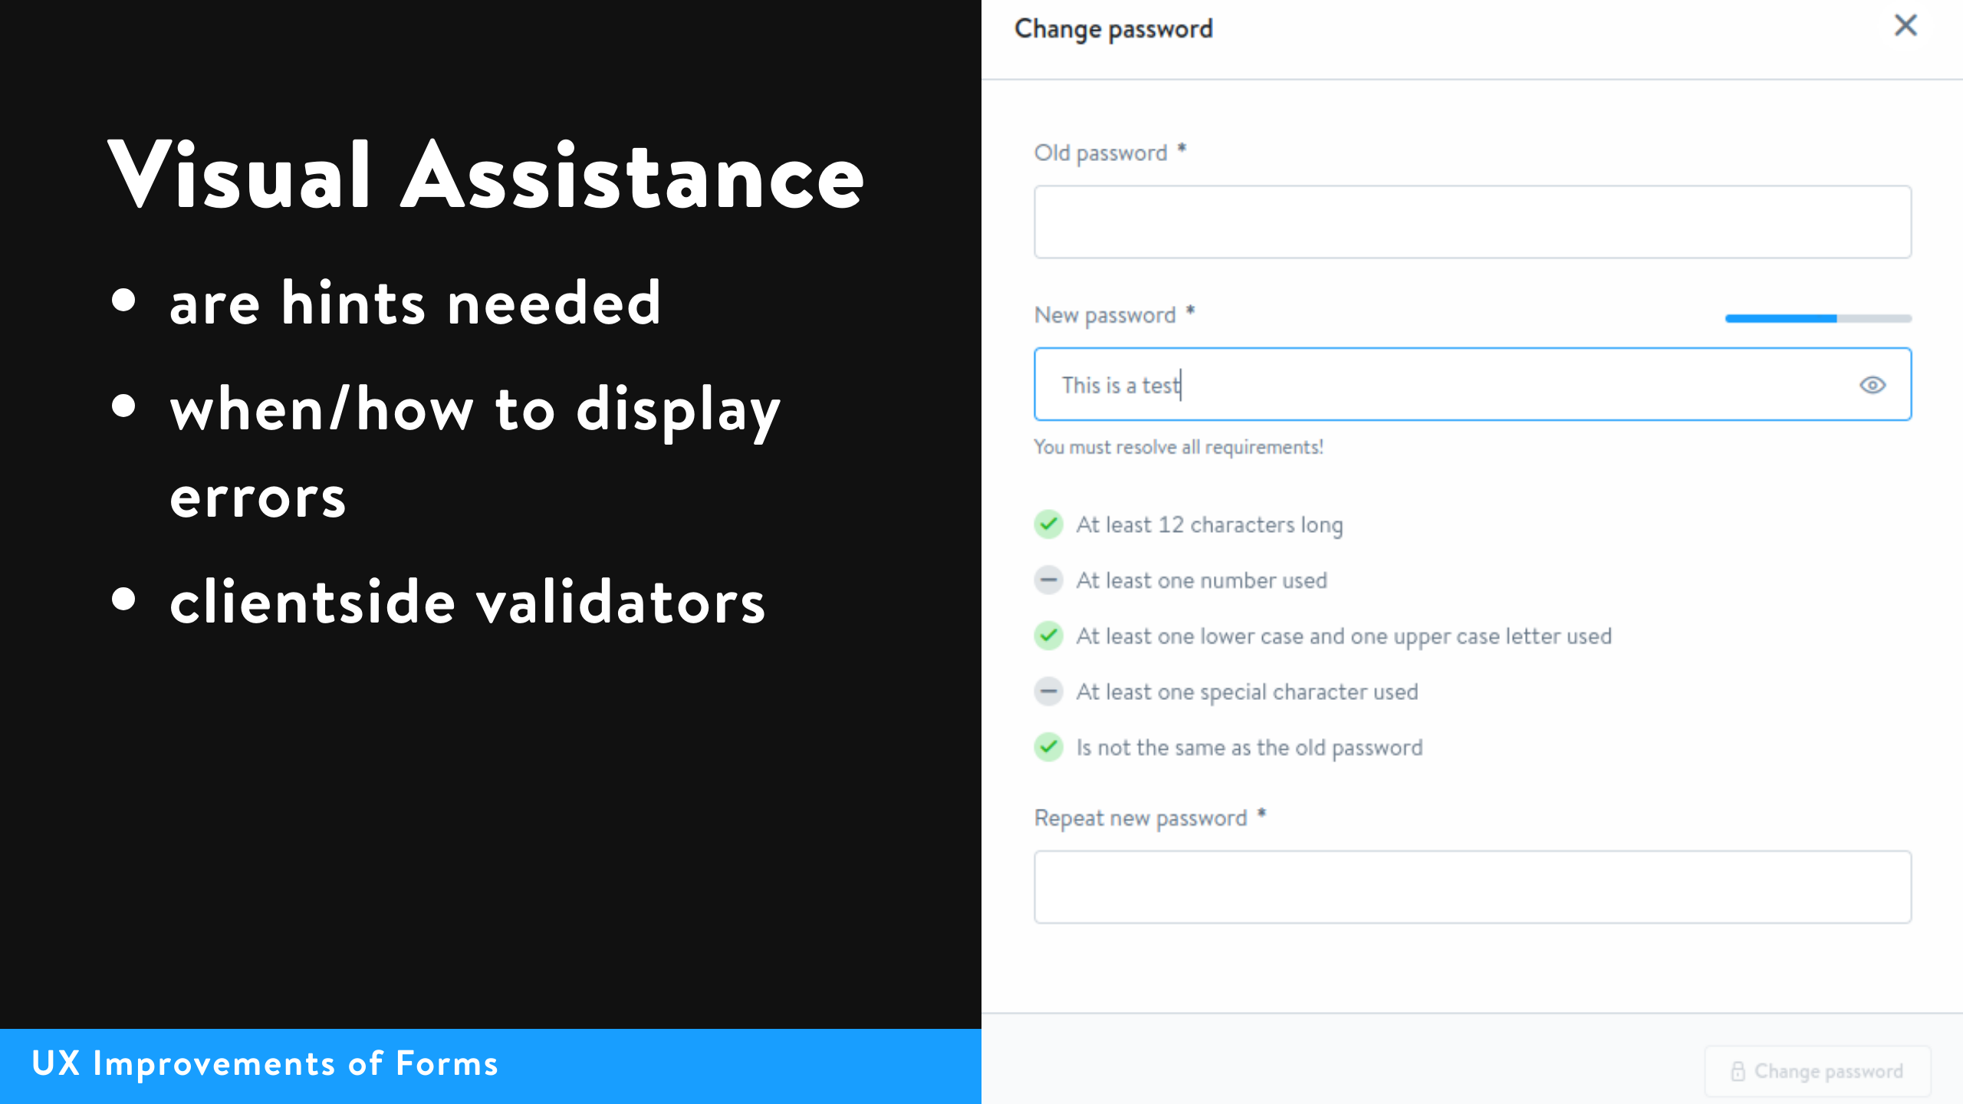
Notes:
hints for everything are not helping, sometimes hints underneath an input is better than (only) placeholder - display errors while typing, after typing or after submitting? are the errors explained? - validate the input on the clientside to provide direct feedback

Slide 17
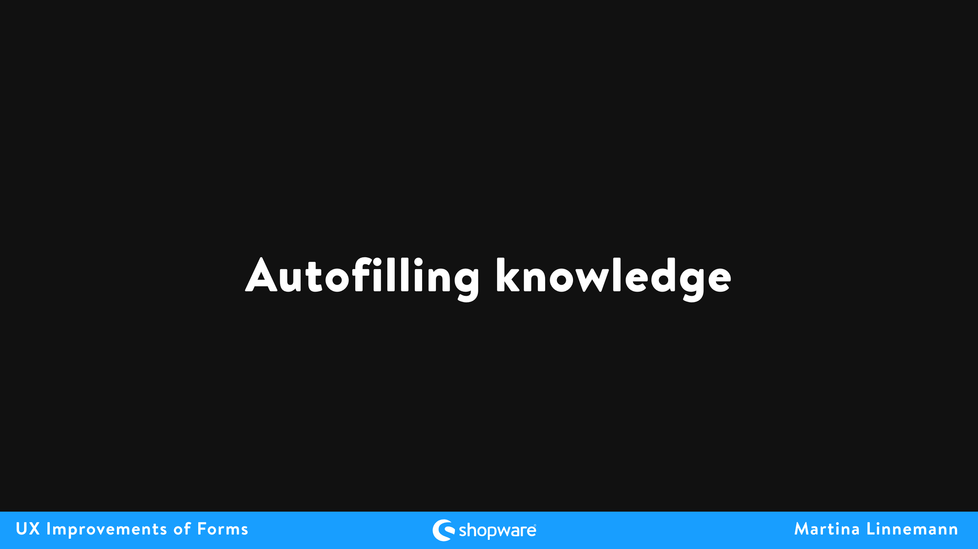

Slide 18
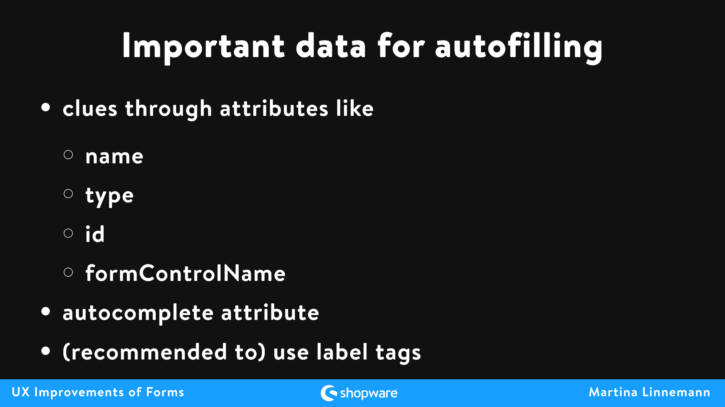
Notes:
-clues are checked against some heuristics, that also may differ between browsers, autocomplete (depending on browser compatibibility) -formControlName is a Angular example, does something like that exist in other frameworks? tell me later

Slide 19
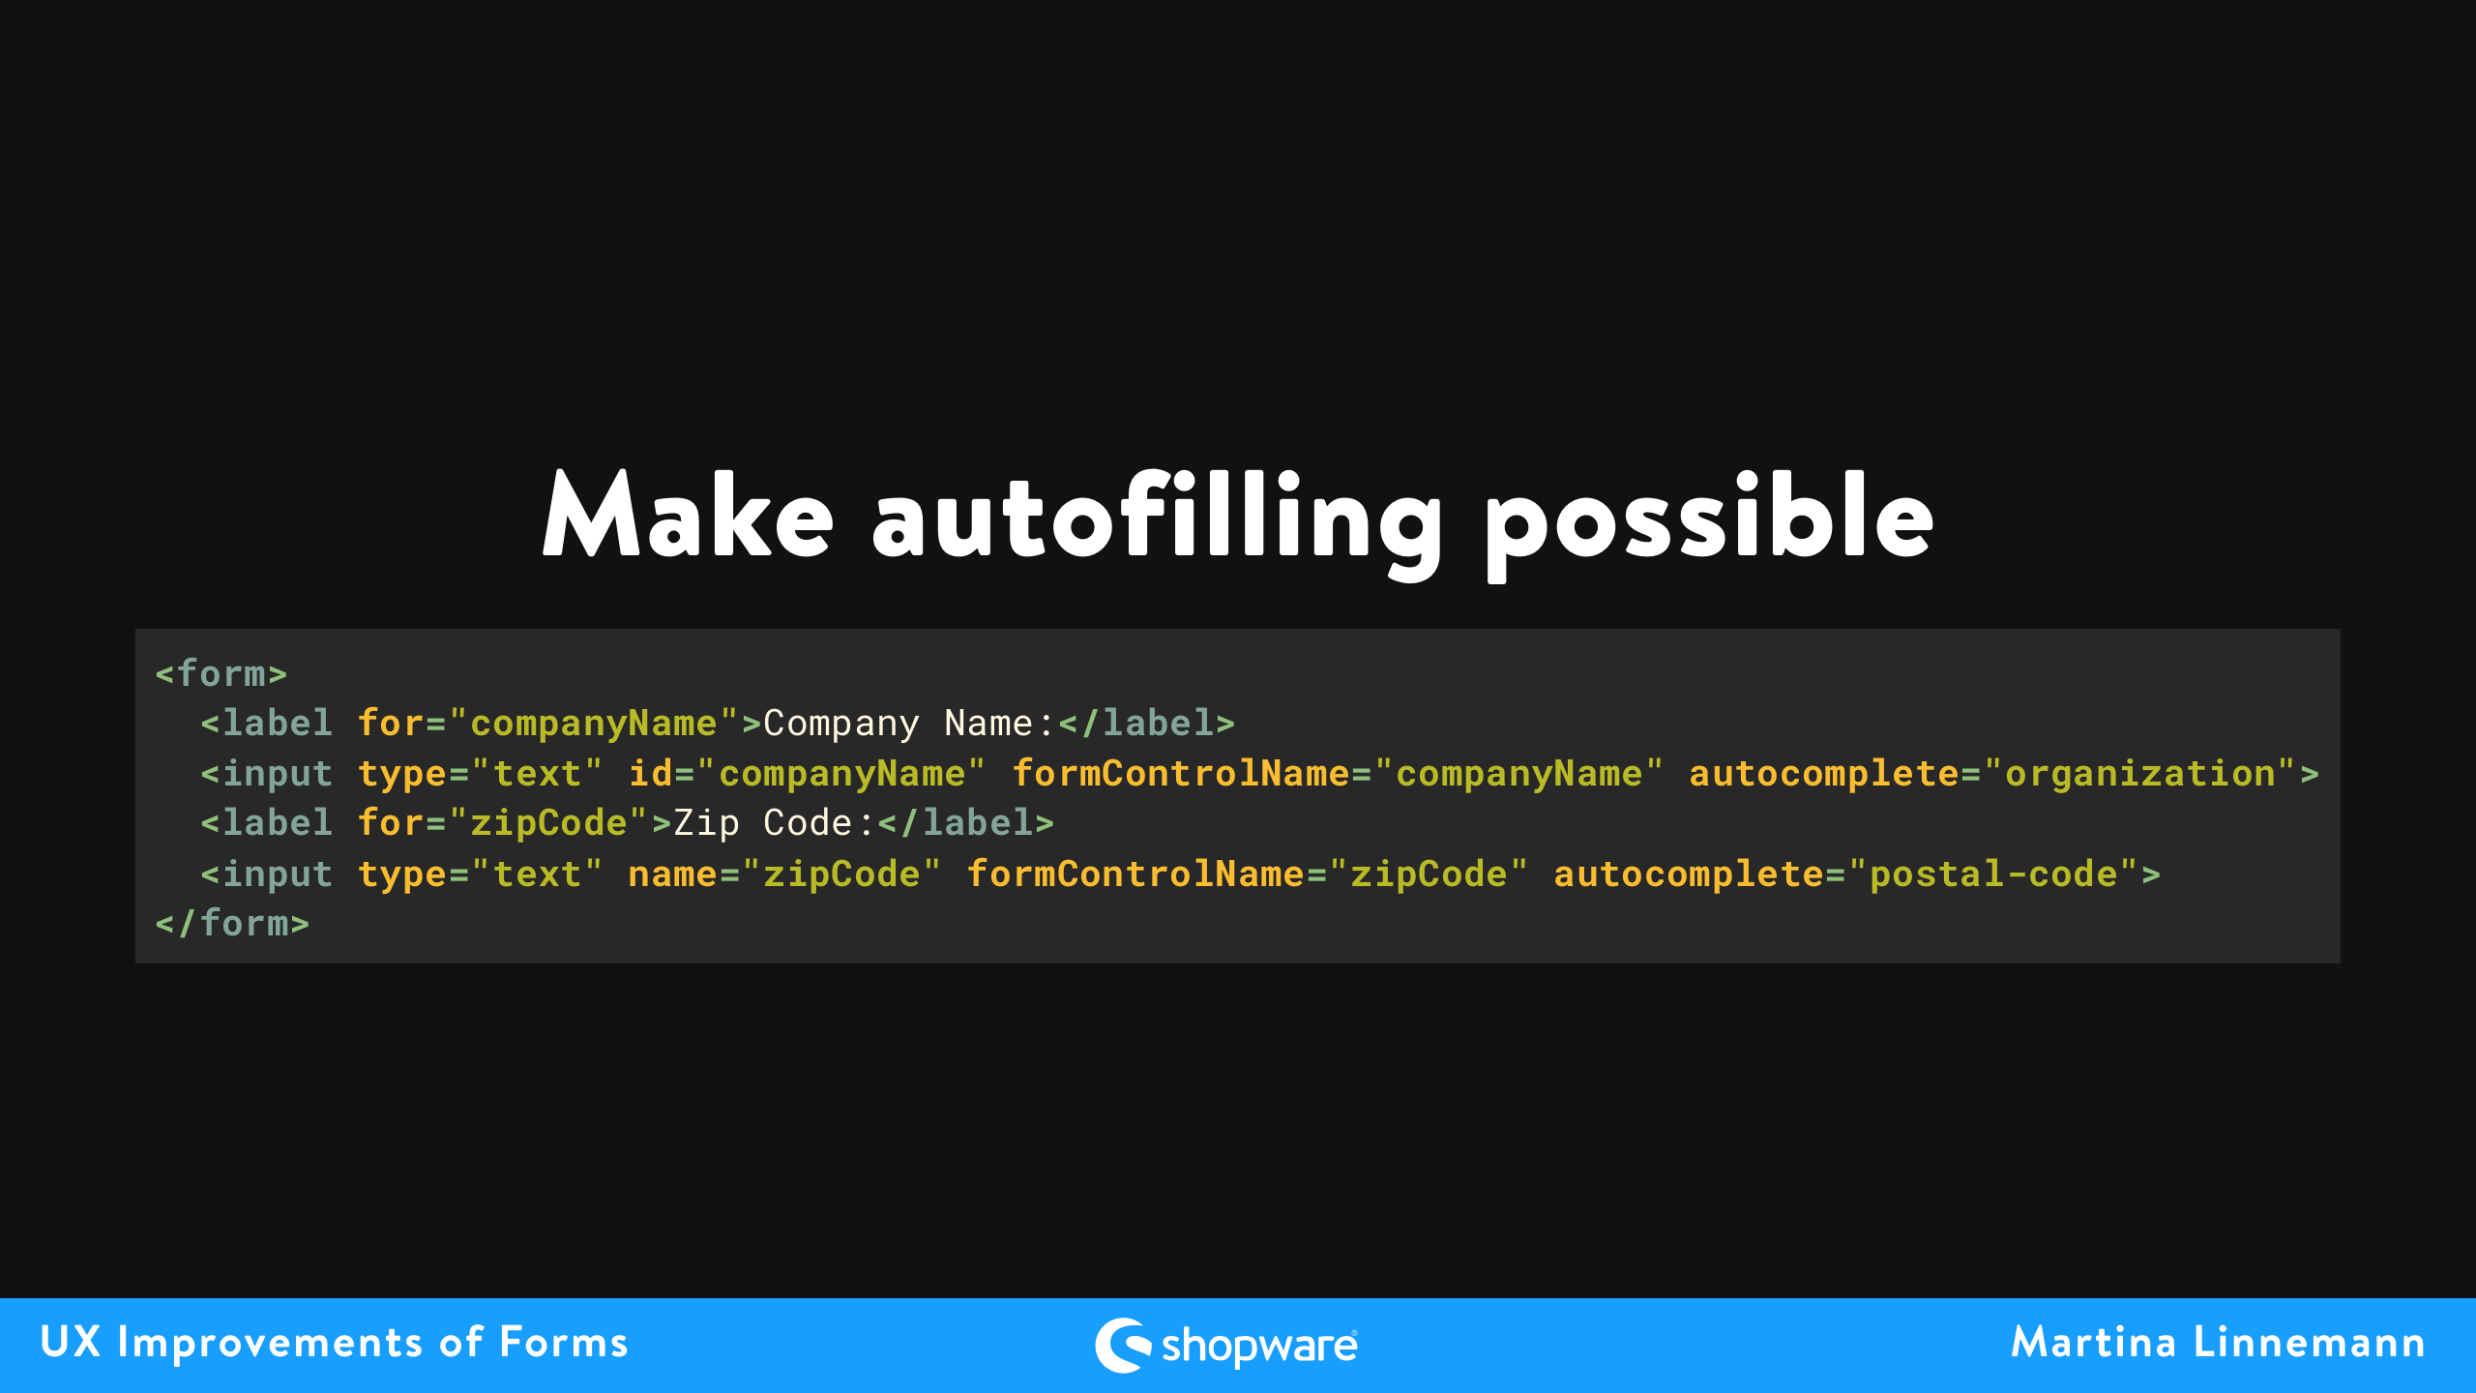
Notes:
to make autofilling possible the best and future proof way is the autocomplete attribute (it is explicit) exact values for autocomplete can be found in the html standard specifications

Slide 20
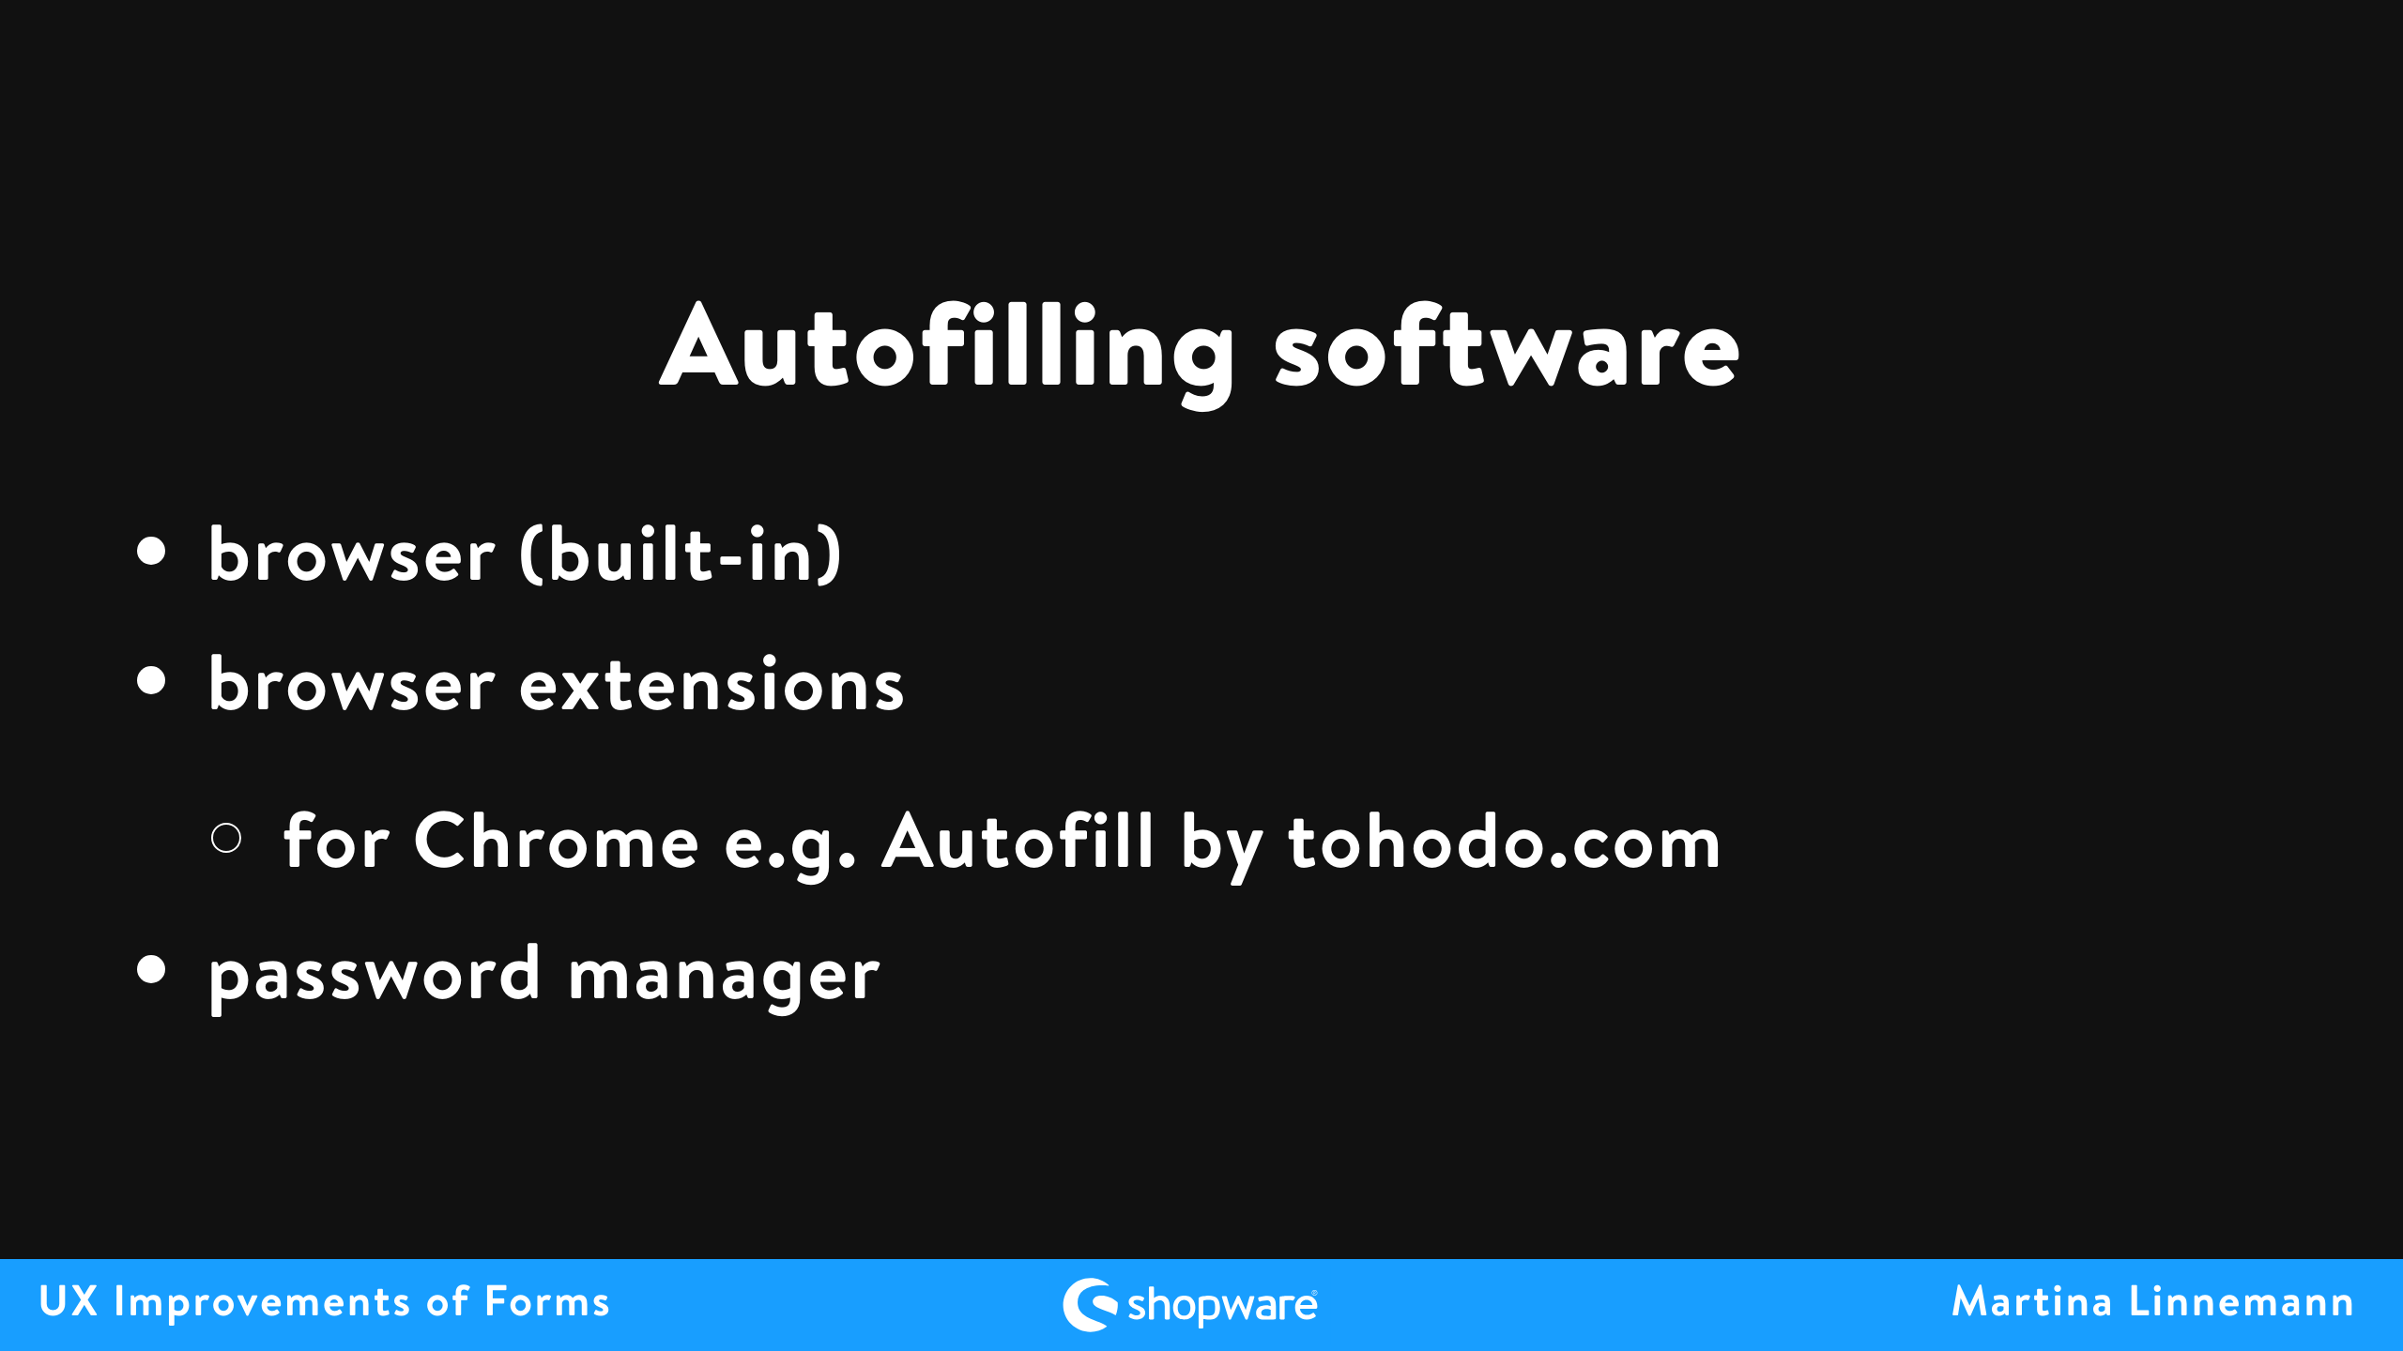
Notes:
differences in beahaviour between different browswrs, extensions, password managers

Slide 21
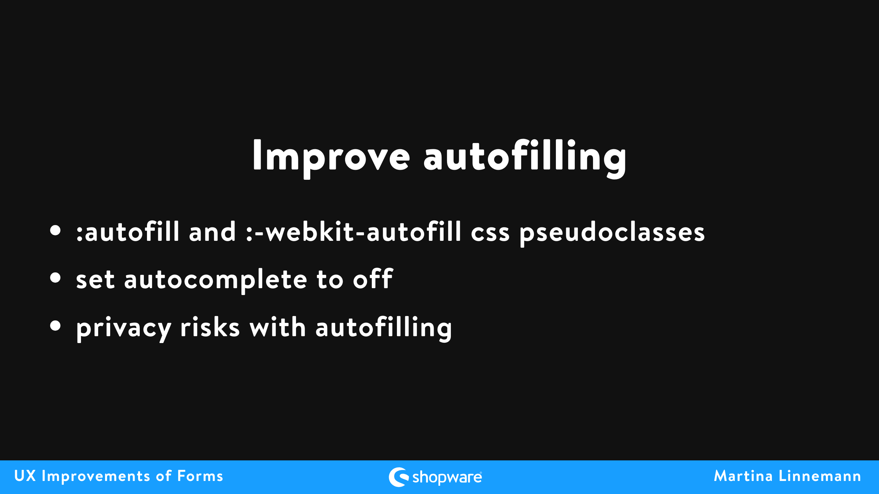
Notes:
- pseudoclasses to make it visible which data was autofilled - autocomplete to off e.g. for one-time passwords - privacy risk as a user, do not enable autofilling without needing to explicitly clicking, check if website trustworthy, make sure to not irritate people with form fields not directly visible

Slide 22
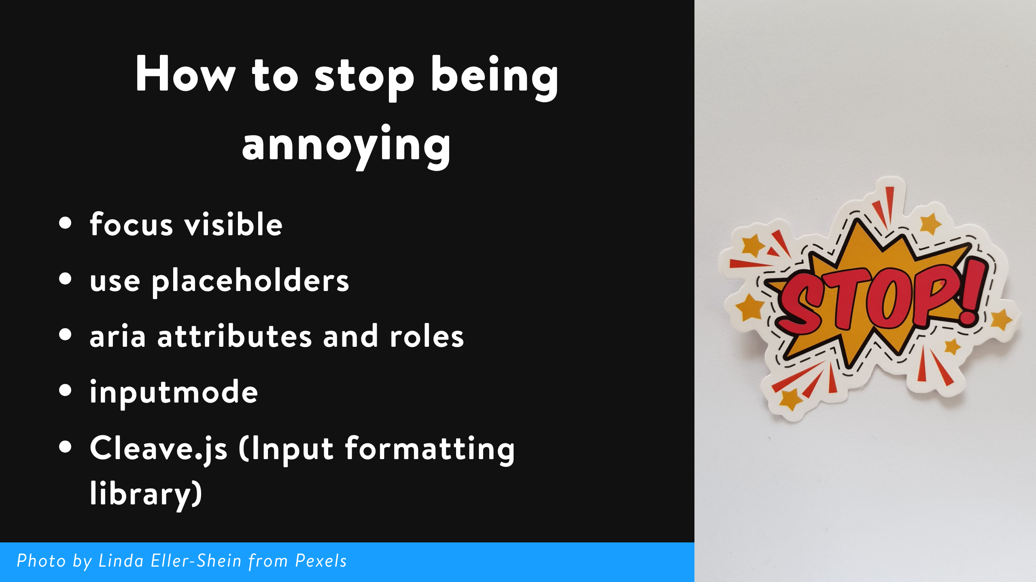
Notes:
smaller side notes for improvements

Slide 23
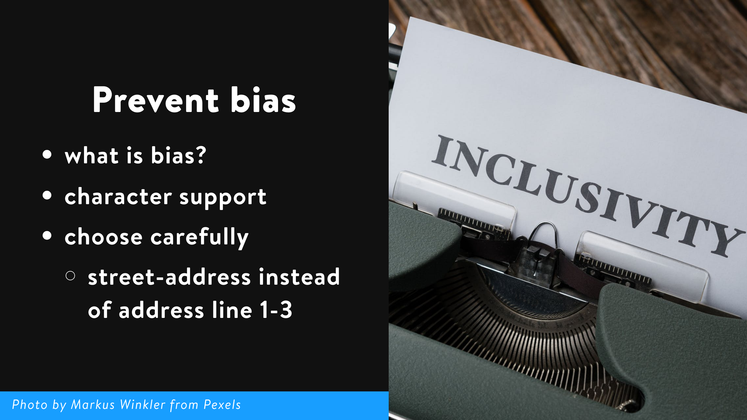
Notes:
- bias is when someone or something favors one thing over another, often unfairly - support think about names that are not german/english - the autocomplete attribute value street-address should be used to avoid bias towards western addresses

Slide 24
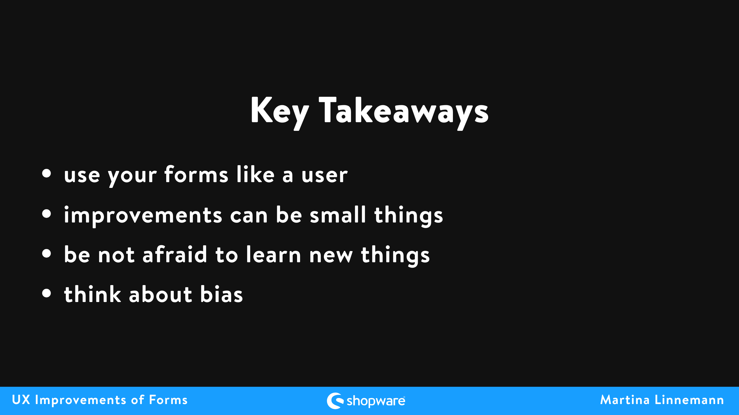
Notes:
some improvements are not that obvious if you don't behave like a user, bias not only from ux perspective a big topic

Slide 25


